Slide 1


Ahead of the Curve
Investing in Canada’s Digital Future

Slide 2
Agenda
About DIGITAL
Overview of this Call for Proposal
Path to Success
Resources & Support
Q&A

Slide 3

Introduction to DIGITAL
Background
Impact
How we work

Slide 4

We unlock the potential of Canadians to lead and succeed in the digital world through a powerful combination of co-investment, cross-industry collaboration, IP creation and digital talent development
1200+ Organizations
Diverse Expertise
Industry: Startups, SMEs, Large, Multinational
Research: Universities, colleges, institutes, Not-for-profits
Governments: Federal, Provincial, Municipal, Agencies
Funders: Venture Capitalists, Banks, Govt-funded Agencies

Slide 5





Snapshot of our Impact*
Catalyzed by our co-investments in 95 projects, our community of 1,200+ organizations
$390M
INVESTED IN CANADIAN SOLUTIONS
160+
450+
GENERATED IP
TO DATE
DEVELOPING
PRODUCTS &
SERVICES
7,000
$828M
SUPPORTED LEARNING &
DEVELOPMENT
PLACEMENTS
RAISED NEW FUNDS
FOR CANADIAN
ORGANIZATIONS
*As of April, 2023

Slide 6
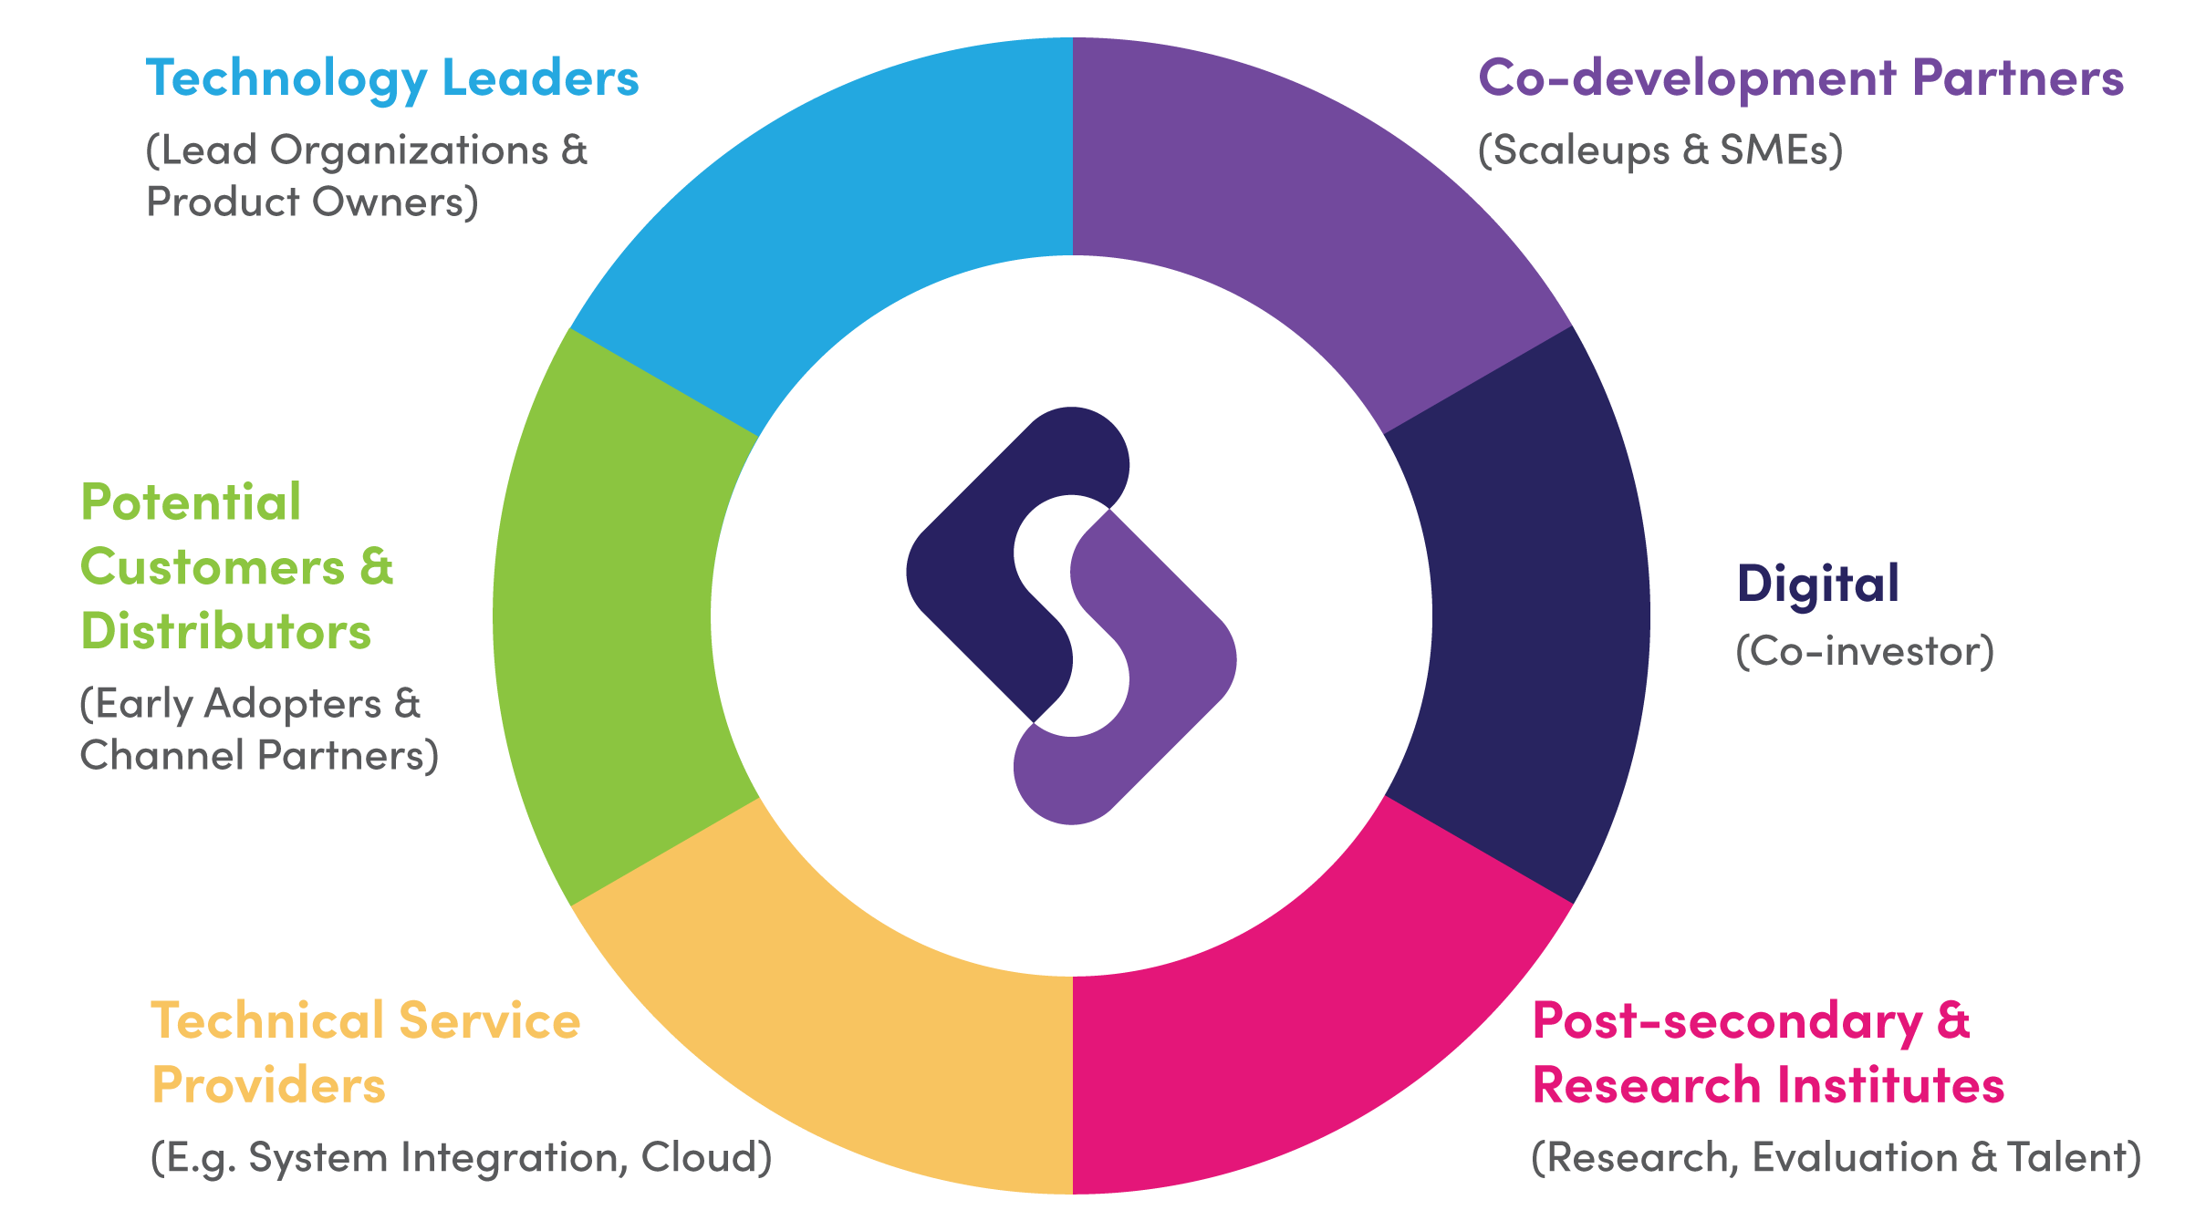
An Innovative Model for Innovation
We invest in digital innovations executed by consortiums led by industry.
This collaborative framework connects industry, academia and customers to commercialize research and create and keep Canadian-owned IP.

Slide 7
Demand-based Thinking Meets Cross-sector Collaboration
Demand-based Collaborative Innovation
Accelerating Development through 1:1.5 Co-investment
Driving Digital Adoption through Customer Voice
Diverse parties: academia, industry leaders, SMEs, public sector develop solutions together better than any single organization could alone.
A co-investment approach de-risks and accelerates the pursuit of breakthrough digital technology and 100% Canadian-owned IP.
The ‘customer voice’ is at the table. Accelerated adoption unlocks opportunities for customers, providers and community.

Slide 8
DIGITAL Associates & Members
Associate organizations can explore the DIGITAL ecosystem and have the potential to be invited by Members to collaborate in projects. Associates are not eligible for funding.
No Membership Fees
Member organizations make a commitment to co-invest in projects alongside DIGITAL and gain access to our funding.
Membership Fee Structure
Project-based Membership Fees | 5% of eligible costs claimed. Amount is deducted at time of claim payment.
Annual Membership Fee | $5,000

Slide 9
Co-Investment Model
Model
Principles

Slide 10
Co-Investment Principles
Costs eligible for DIGITAL co-investment must be incremental, reasonable and directly relate to the project activities during the project term
Expenses are co-invested on a cost basis
  Salaries and MERC
  Capital Expenditures (pre-approval from DIGITAL required for over $1M)
  Foreign Costs (pre-approval from DIGITAL required)
Consortium Partners can not make a profit
  Actual co-investment will be based on claims showing real costs incurred
‘Skin in the Game’: All consortium members must have a meaningful level of co-investment (financial, service commitments or in-kind) in the project
“Co-investment” refers to the concept that the consortium partners, including DIGITAL, are sharing in the total investment required to fund the collective costs for a specific project.
DIGITAL will only provide co-investment payments to an Eligible Member for any Eligible Costs incurred after a Master Project Agreement has been executed.

Slide 11
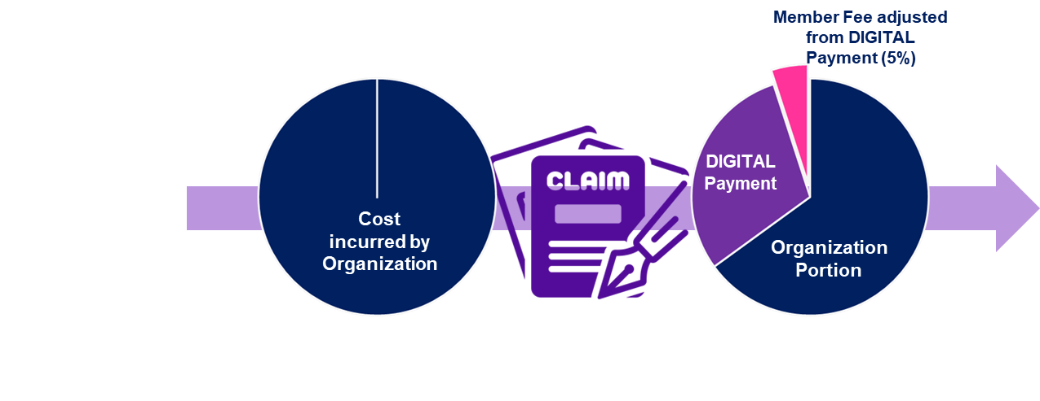
Co-Investment Model
Co-investment is based on a cost recovery model of eligible expenses
  Project partners incur the costs and then claim DIGITAL funds.
  All organizations are expected to fund their own work and support their cash flow throughout the project.
  Eligible Expenses: direct and incremental costs linked to project outcomes including salaries, subcontractors, equipment purchases, and travel
  DIGITAL’s payments are made on actual project costs incurred on a quarterly basis following project team confirmation that it has fulfilled its commitments.
Co-investment is calculated as 35% of eligible costs for eligible Members
  Adjustments includes Project-based Membership Fees @ 5% of eligible costs claimed and GST/PST
Co-investment is provided to eligible organizations who are DIGITAL Members
  For-profit (industry) Members
  Not-for-profits Members with funding primarily sourced from private organizations
  Non-federal Crown corporations whose funding is derived from commercial activities
  Indigenous organizations

Slide 12
Call Overview
Overview
Areas of Interest
Eligibility for Participation
Application & Selection Process

Slide 13

Call for Proposals
With co-investment from the Government of Canada through the Global Innovation Cluster program and the Pan-Canadian Artificial Intelligence Strategy, DIGITAL is mobilizing break-through technology innovation that:
Supports health and wellness by providing more equitable access to care, improving health outcomes and enabling sustainable healthcare systems in Canada and around the world.
Advances environmental health and strengthens Canada’s natural resources sectors to succeed in a prosperous, low carbon economy.
Captures economic potential of made-in-Canada AI technology solutions through technology commercialization, talent development and creating global advantage.

Slide 14
Call for Proposals | Programs
Technology Leadership (Cycle 6) $65M investment from the federal Global Innovation Clusters program focused on development of novel and innovative digital technology solutions in health and natural resources.
Project Team: minimum 3 partners: at least one SME, at least one academic/research, at least one target customer
Horizon AI - Technology Commercialization $20M investment from the Commercialization Pillar of the federal Pan-Canadian AI Strategy (PCAIS) to drive the commercialization and adoption of made-in-Canada AI solutions.
Project Team: minimum 3 partners: at least one SME, academic/research recommended, at least one target customer
Project Size: $20+M in total costs
Project Design:
Innovation and R&D → generation of Foreground IP in Canada
Include deployment with at least one pilot customer
Project should have at least one gate that confirms technical validity and commercial viability for partners to continued investment
Project Size: $3+M in total costs
Project Duration: 1+ years (to end by Dec. 2025)
Project Design:
Focused on configuration and customization of AI technology solution (around TRL 7) for first time or new sector/market deployment
Project Duration: 3+ years (to end by Dec. 2027)
Include work related to “Proof of Value” e.g. feasibility studies, evaluation, etc.
May include pre-defined conditions to enter a commercial agreement during or after the project.
May include least one gate to confirm technical validity and commercial viability for continued investment
Include work related to “Proof of Value” e.g. feasibility studies, evaluation, etc.

Slide 15


Technology Leadership | Areas of Interest
Digital solutions to support the resiliency and sustainability of health care systems and advance health care
Better access to health care: enable people to confidently manage their health and wellness at home and in their communities.
Digital solutions to support environmental health and strengthen the natural resources sector to succeed in a prosperous, low carbon economy.
Sustainable, low impact mining: reduce the generation of waste and large tailings. Identify and address environmental impacts, lower investment costs, and improve the identification, extraction and processing of critical minerals.
Regenerative agriculture supply chains: advance food security, improve yield and optimize logistics while promoting plant vigor, biological diversity, pest and disease control, and soil as an asset for the natural sequestration of carbon dioxide.
Resilient forestry: effectively manage and optimize forestry assets, supply chain operations, and the ecological health of forests, including its critical role in carbon sequestration.
Improved outcomes: support patients, families and caregivers & clinicians to deliver diagnostic results, adhere to high-quality standards of care, and facilitate the best treatment and care plans.
Achieving more sustainable healthcare systems: reduce administrative burden, decrease costs and eliminate duplication, and improve data sharing and interoperability to facilitate integrated and coordinated patient-centered care.

Slide 16
Technology Leadership | Eligibility Criteria
Aim to develop and commercialize novel technology solutions
Have a minimum total cost of $20M and be completed before December 31, 2027
Have a committed consortium¹ that demonstrates high potential for scaling growth
  At least one Canadian SME
  At least one academic/research partner
  At least one target customer
  Encourage non-Canadian/multi-national participants as customers and/or distribution partners
  A proven commercial track-record and a strong understanding of their target markets with a compelling commercial strategy.
Drive the creation of new intellectual property that is owned by Canadian entities that have substantial operations in Canada
Meet the eligibility requirements defined in the Cycle 6 Program Guide
¹ Project Partners must be a DIGITAL Member or Associate at the time of submission. The lead organization must be a Member in good standing at the time the EOI is submitted to be considered. Organizations seeking DIGITAL co-investment must be a Member in good standing before contract (MPA) signed.

Slide 17


Technology Leadership | Application Process
Expression of Interest
Assessment of eligibility, fit and completeness of project idea, team, execution and commercial strategy
Internal evaluation by DIGITAL team
Full Project Proposal
Determination of scaling potential of project idea, team, commercial and ecosystems
Independent Project Selection Committee (PSC)
FPP
EOI
Register Project Concept via online Intake Form
Contracting (Master Project Agreement)
Submission via the Proposal Portal
Access is provided to the primary proposal contract at time of Intake Form submission.

Slide 18
Technology Leadership | Estimates Call Timelines
No Deadlines | Continuous Intake until all funds are committed
Submissions evaluated based on first completed submission, first evaluated
Earliest FPP submissions expected
Earliest EOI submissions expected
Call Launch:
31 May 2023
As $ are committed, our website will be updated to show how much funding is left.
May
June
July
August
September
October
Concept Intake
EOI Development
FPP Development | Selection
Contracting (60 days)

Slide 19
Technology Leadership | Evaluation Criteria
Team & Management Plan | 25%
Commercial Impact | 35%
Technology Innovation | 25%
Ecosystem Impact | 15%

Slide 20
Path to Success
Team & Management Plan
Commercial Impact
Technology Innovation
Ecosystem Impact

Slide 21

General Tips
Agree on a single proposal writer to “hold the pen”
Remain disciplined to maintain the team momentum. This is a marathon not a sprint.
Ensure the Eligibility and Evaluation Criteria (see Program Guide) are met
Start the hard conversations early (hint: these are often in relation to IP creation, ownership and sharing, and go-to-market commercial arrangements)
Keep a product/commercial focus from the outset
Reach out to the DIGITAL team for support
Highly recommend that a 3rd party PM is engaged starting from the FPP development

Slide 22
Team & Management Plan
Strong and strategically aligned project partners
Establish effective project management and governance model
Clear accountabilities and decision making
Defined and measurable innovation and R&D outcomes
Defined and measurable checkpoints/gates for validations and replanning
Understand your gaps
Avoid creating an echo chamber
Consider leveraging the relationships beyond the project

Slide 23
Technology Innovation
Build for commercialization
Consider ethics (safe and responsible technology use) from the outset
Design a coherent plan for IP management
If using 3rd party IP, understanding the implications on development and commercialization
Understand and prepare for data sharing within the project
Understand the data sharing requirements of the customers

Slide 24
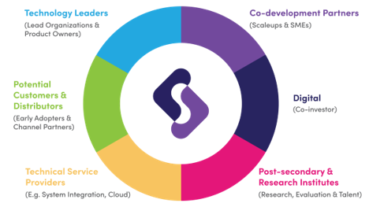
Commercial Impact
Discuss and agree on the principles for the commercial arrangements between the project partners
Understand your market: purchaser, end-user, procurement processes, regulatory environment, competitors (including alternate approaches) including global target markets
Build clarity around your value proposition. How can this be demonstrated for future commercial success
Consider how project partners may support go-to market
Consider how the ecosystem may enable/support go-to market

Slide 25
Ecosystem Impact
Understand and leverage your ecosystems for the project, post-project and beyond the project participants
Contribute to the ecosystem through meaningful contributions to a diverse and inclusive digitally skilled workforce, SME benefits beyond the consortium, advancement of research and social good
Consider opportunities for the project to influence standards definitions and regulations
Consider benefits to Canada beyond commercial success of the project participants

Slide 26
Resources & Support

Slide 27


Resources
Website
Program and Co-Investment Guides
FAQs
Updates and Announcements
Webinar Links
Concept Intake Submission
Community Portal (Associate & Member Access only)
DIGITAL reports
Project-related templates (reporting, approvals, policies)
Access to Proposal Portal (access given upon Concept submission)

Slide 28

Support
Proposal Support email: proposal-support@digitalsupercluster.ca
Investment Lead. one-on-one support. Investment Leads are assigned to eligible proposal teams and will provide guidance through the proposal process.

Slide 29
Next Steps
Review the Program & Co-investment Guides
Formulate project concept
If you have questions, reach out to DIGITAL support team
Submit your project concept via our website

Slide 30

Canada-Wide
Global Impact.
Let’s Talk.
digitalsupercluster.ca
info@digitalsupercluster.ca
the-digital-technology-supercluster
@DTSupercluster

Slide 31



We are grateful to the people of the xʷməθkʷəy̓əm (Musqueam), Sḵwx̱wú7mesh (Squamish), and Sel̓íl̓witulh (Tsleil-Waututh) Nations for sharing and stewarding these lands.
31
Notes:
Remove.

